Slide 1








MADEIRA INTERNATIONAL WORKSHOP IN MACHINE LEARNING
Premium sponsor:
Gold sponsor:
Bronze sponsor:
2022

Slide 2
Contents
Image Classification Applications
Images
Image Classification Framework
Challenges for Image Classification tasks
Data Augmentation
Data Augmentation in Practice
.

Slide 3
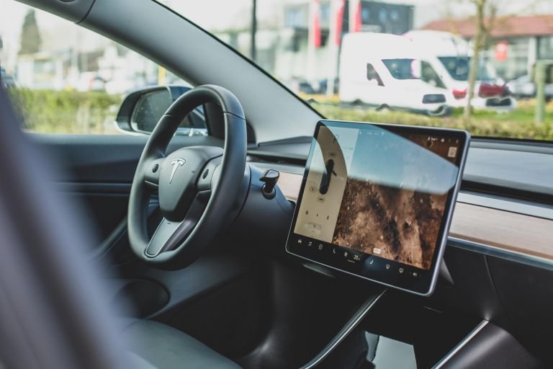
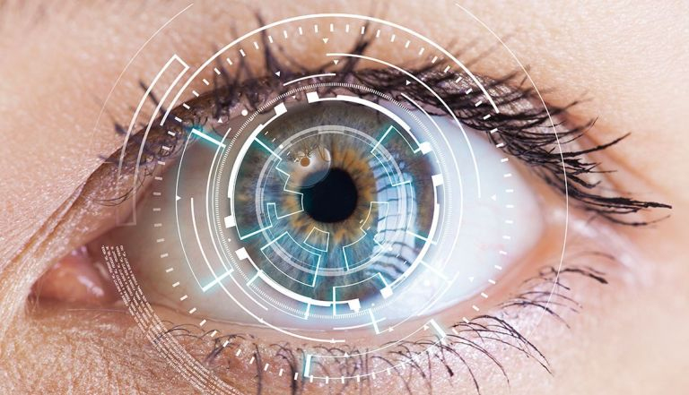
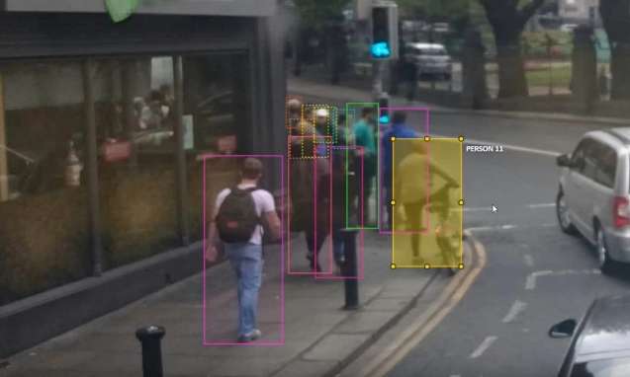
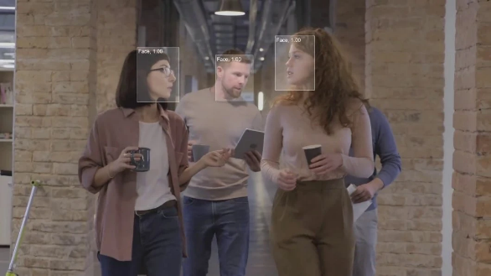
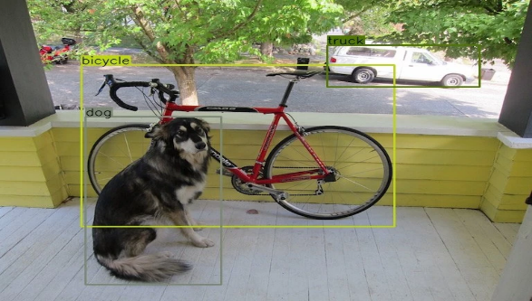
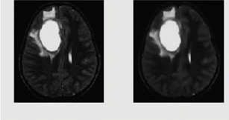
Image Classification APPLICATIONS
Self driving cars
Biometric Recognition
Image Annotation
.
Tumour detection
Face Recognition
Object Detection

Slide 4
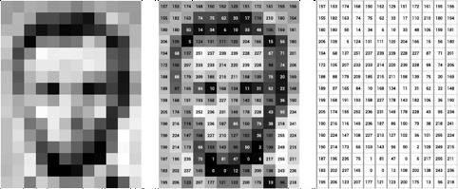
DIGITAL IMAGE
A Digital image is a 2D matrix made up of small box units called pixel.
The numerical value for each pixel depicts its intensity.
The intensity can range between 0-255.
pixel
Fig 1. Digital Image (Black and white) Representation
*https://datascience.aero/computer-vision-seeing-interpreting-images/

Slide 5
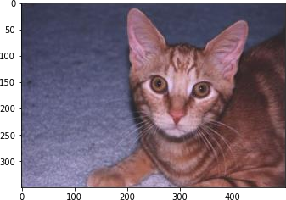
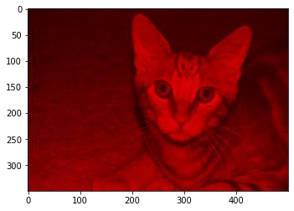
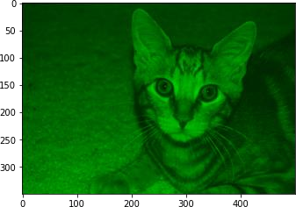
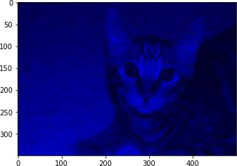
COLOR IMAGES
Colored image consist of three channels: Red, Green and Blue.
Each channel intensity value may range between 0 and 255.
Hence, each pixel is represented by three values. Different intensity values from these channels defines the object’s color.
RGB image
R-channel G-channel
Fig. 2. Colored image and its R,G and B channels.
B-channel

Slide 6
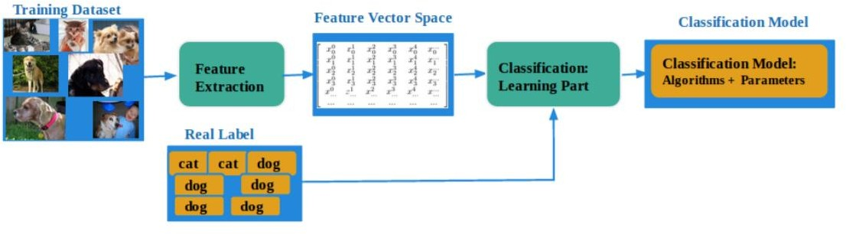
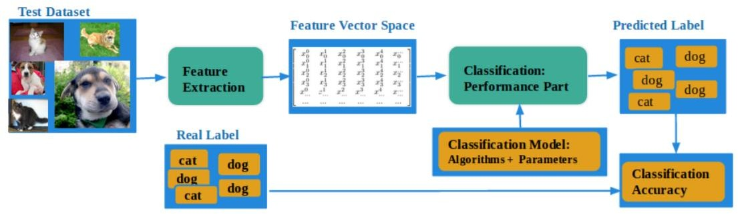
IMAGE CLASSIFICATION FRAMEWORK
Fig 4. Image classification Framework (a) Training framework (b) testing framework.

Slide 7
Challenges
Limited data availability due to data cleaning.
Limited labelled training samples (Supervised Learning).
Limited Data diversifications.
Difficulty in creating Generalised deep learning models.

Slide 8
Solution
Data Augmentation

Slide 9
Data Augmentation
It is a technique to create a diverse training dataset for robust models.
It deals with applying image transformations such as image restoration, flipping, resizing etc.
It should be applied to training data only.

Slide 10
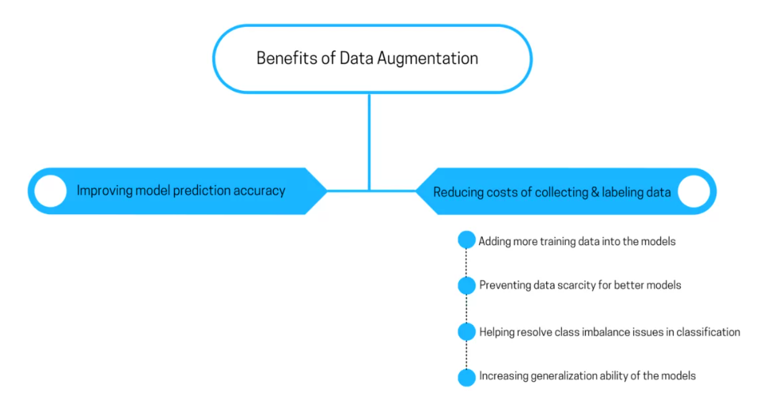
Data Augmentation

Slide 11
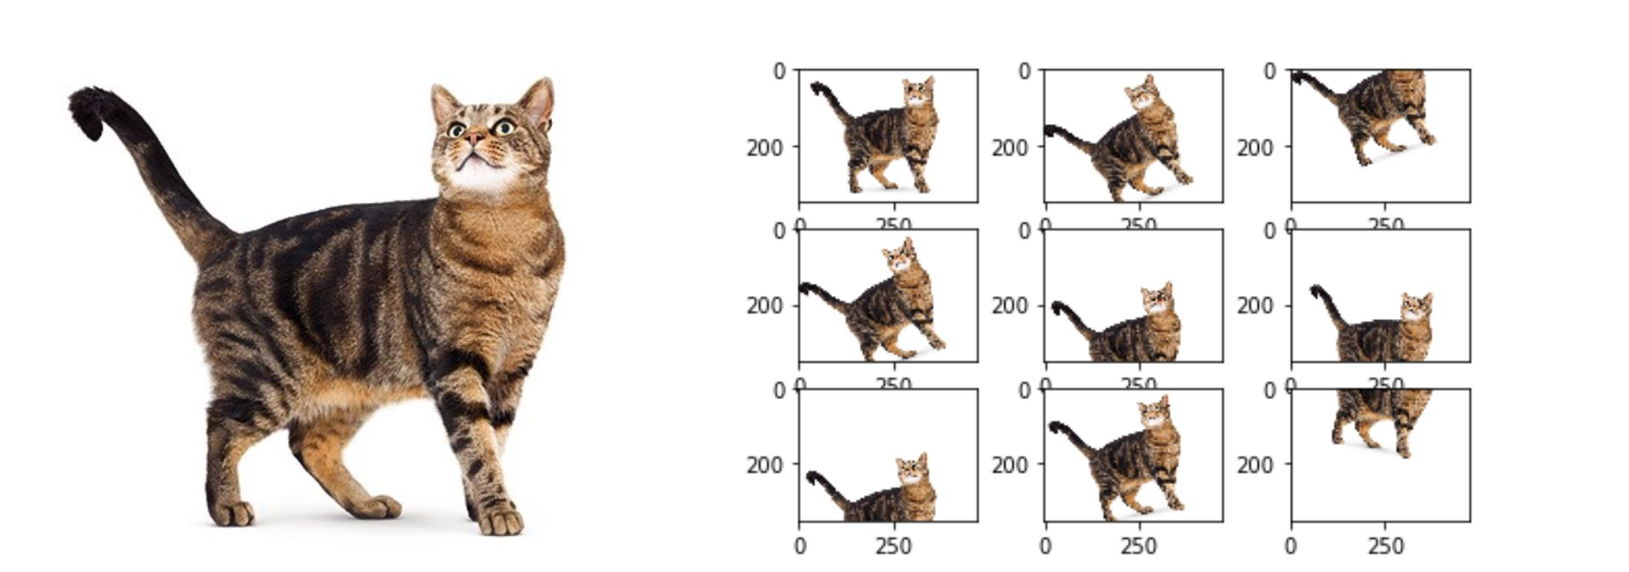
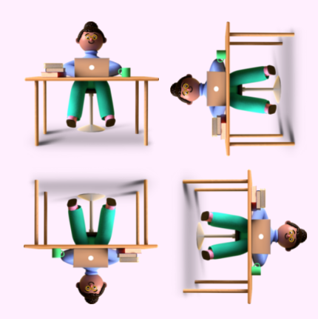
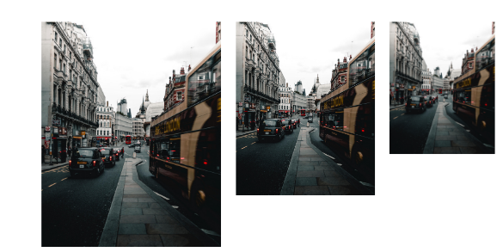
ImAGE AUGMENTATION
a. Image rotation and width-height shift
c. Horizontal and vertical flip
b. Image resizing

Slide 12
Data Augmentation in Practice

Slide 13
Data Augmentation
Fashion MNIST
Fashion MNIST
Dataset
Dataset
Training
(50,000)
Testing
(10,000)
Training
(50,000)
Testing
(10,000)
Image Augmentation
Model Training
Model Training

Slide 14
DATASET INFORMATION
Inputs: Grayscale Images (60,000 training, 10,000 testing)
Classes: 10 (Needs to be converted to one-hot encoding format)
In this type of encoding ,the sample belonging to particular class is assigned a value 1 and, 0 for other classes. For instance, imagine following are the labels for dog-cat classification.
Categories
Cat
Dog
Cat
Dog
Cat
Cat | Dog
1, | 0
0, | 1
1, | 0
0, | 1
1, | 0

Slide 15
Image Augmentation Used
Pixel normalization: by dividing each pixel value by 255.
datagen = ImageDataGenerator(
featurewise_center=False,
samplewise_center=False,
featurewise_std_normalization=False,
samplewise_std_normalization=False,
zca_whitening=False,
rotation_range=60,
width_shift_range=0.03,
height_shift_range=0.03,
horizontal_flip=True,
vertical_flip=True)

Slide 16
Results
Metrics | W/O Augmentation | W/ augmentation
Training Loss | 0.34 | 0.28 (-0.6)
Testing Loss | 0.33 | 0.31 (-0.2)
Training Accuracy | 0.87 | 0.90 (+3%)
Testing Accuracy | 0.88 | 0.89 (+1%)

Slide 17
Thank You

